Slide 1
2020Assessment of the Efficiency of the Administrative Mechanism (AEAM) (3/1/2020 through 2/29/2021) STEERING COMMITTEE November 9, 2021
Notes:
Are your classroom colors different than what you see in this template? That’s OK! Click on Design -> Variants (the down arrow) -> Pick the color scheme that works for you!
Feel free to change any “You will…” and “I will…” statements to ensure they align with your classroom procedures and rules!

Slide 2
What is the Assessment of the Efficiency of the Administrative Mechanism (AEAM) and why do we do it?
The purpose of this project is to conduct the Assessment of Efficiency of the Administrative Mechanism (AEAM). Federal legislation requires each Ryan White Part A Planning Council to assess the efficiency of the administrative mechanism. This mean the efficiencies of the Administrative Agent, the City of Paterson, New Jersey, Bergen-Passaic TGA Ryan White Part A Program, to rapidly allocate funds to the areas of greatest need within the TGA, and at the discretion of the Planning Council, assess the effectiveness of the services offered in meeting the identified needs.
The City of Paterson, New Jersey, Bergen-Passaic TGA Ryan White Part A Program, served as the Recipient for administering the Ryan White Part A Program (RWPA) for this reporting period. The purpose of the Assessment is to ensure that service prioritization and allocation, as determined by the Planning Council during their Priority Setting and Resource Allocations (PSRA) process are adhered to.
The AEAM will also assess efficiencies in the Recipient’s ability to procure services through contracting and reimbursement processes. Ultimately, the Planning Council will assess the Recipient’s ability to facilitate access to primary medical care and other ancillary services by Persons Living with HIV/AIDS (PLWH).
The Executive Committee of the Planning Council develops the timeline and Scope of Work for the Assessment of the Efficiency of the Administrative Mechanism for the TGA.

Slide 3
AEAM Questions to Subrecipients
Questions
1. During the 2020 grant year (March 1, 2020 - February 29, 2021), did your agency receive an executed contract within 45 days of your letter of award issued by the Recipient's Office (City of Paterson)? 2. During the 2020 grant year (March 1, 2020 - February 29, 2021), did your agency receive payment from the City of Paterson within 30 days of submitting a correct cash voucher/reimbursement request to the Recipient's Office? 3. During the 2020 grant year (March 1, 2020 - February 29, 2021), did your agency receive a notification from the Recipient's Office that your cash voucher/reimbursement request needed to be modified/corrected? 4. During the 2020 grant year (March 1, 2020 - February 29, 2021), on average, how many days elapsed between the day you submitted your cash voucher/reimbursement request and the date you were notified by the Recipient's office that corrections were needed?

Slide 4
AEAM Questions to Subrecipients
Questions
5. During the 2020 grant year (March 1, 2020 - February 29, 2021), did your agency submit a budget modification/amendment (request to change the amount of money allocated to a service category) to the Recipient's office? 6. During the 2020 grant year (March 1, 2020 - February 29, 2021), on average, how many days did it take for the Recipient's office to approve the requested budget modification/amendment? 7. During the 2020 grant year (March 1, 2020 - February 29, 2021), did your agency receive a Program Monitoring (chart audit for services) visit? 8. During the 2020 grant year (March 1, 2020 - February 29, 2021), did your agency receive a Fiscal Monitoring (audit for Ryan White expenses) visit? 9. During the 2020 grant year (March 1, 2020 - February 29, 2021), did your agency request any technical assistance from the Recipient's office?

Slide 5
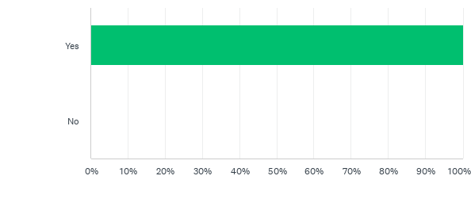
During the 2020 grant year (March 1, 2020 - February 29, 2021), did your agency receive an executed contract within 45 days of your letter of award issued by the Recipient's Office (City of Paterson)?
RECIPIENT RESPONSE:
All Subrecipients were issued a Notice of Award for the 2020/21 grant year on March 1, 2020. However, executed contracts took up to 60+ days due to edits of budgets and submission of correct documents from Subrecipients.
SUBRECIPIENT RESPONSES:

Slide 6
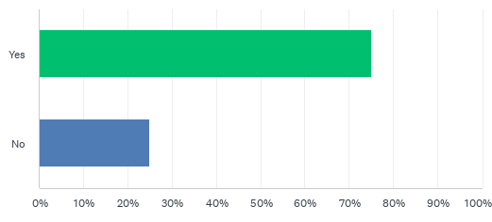
During the 2020 grant year (March 1, 2020 - February 29, 2021), did your agency receive payment from the City of Paterson within 30 days of submitting a correct cash voucher/reimbursement request to the Recipient's Office?
RECIPIENT RESPONSE:
Subrecipient reimbursement requests that took longer than 30-days due to late submissions by subrecipients and COVID-19. Also corrections or adjustments to the vouchers/reimbursement request took longer because submissions for reimbursement on average were greater than 60-days due to COVID-19.
SUBRECIPIENT RESPONSES:
There were many delays, some were incorrect vouchers, but many was delay in payment.

Slide 7
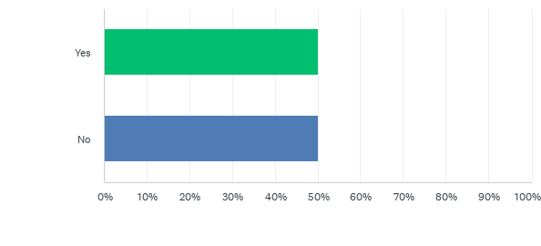
During the 2020 grant year (March 1, 2020 - February 29, 2021), did your agency receive a notification from the Recipient's Office that your cash voucher / reimbursement request needed to be modified/corrected?
RECIPIENT RESPONSE:
There were numerous vouchers that were returned to Subrecipients for correction/adjustments. Many voucher requested were not submitted to the recipient in a timely manner due to COVID-19.
SUBRECIPIENT RESPONSES:
All vouchers were correct.

Slide 8
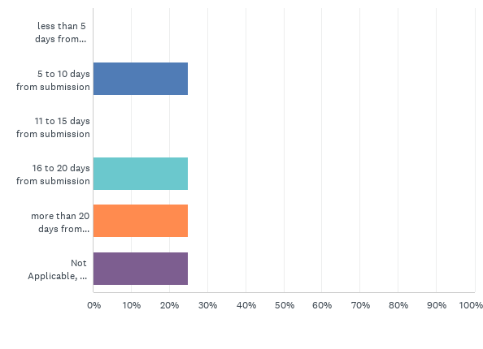
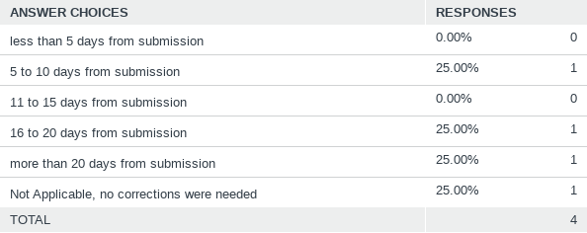
During the 2020 grant year (March 1, 2020 - February 29, 2021), on average, how many days elapsed between the day you submitted your cash voucher/ reimbursement request and the date you were notified by the Recipient's office that corrections were needed?
RECIPIENT RESPONSE:
Subrecipients were notified within 30-days of submission of their voucher/reimbursement that corrections needed to be made so that it could be processed for reimbursement. In many cases, corrections took place after the reimbursement took place due to COVID-19.
SUBRECIPIENT RESPONSES:

Slide 9
During the 2020 grant year (March 1, 2020 - February 29, 2021), did your agency submit a budget modification/amendment (request to change the amount of money allocated to a service category) to the Recipient's office?
RECIPIENT RESPONSE:
Some subrecipients were awarded additional funds after the Planning Council reallocated funds from underspent service categories.
SUBRECIPIENT RESPONSES:

Slide 10
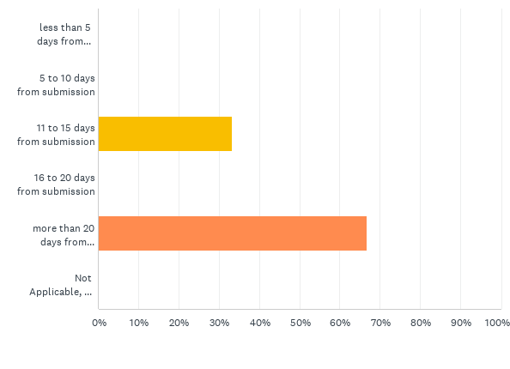
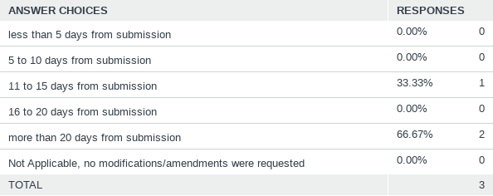
During the 2020 grant year (March 1, 2020 - February 29, 2021), on average, how many days did it take for the Recipient's office to approve the requested budget modification/amendment?
RECIPIENT RESPONSE:
All budget modifications were approved within 60-days of submitted request. COVID-19 increased the timeframe for budget modifications.
SUBRECIPIENT RESPONSES:

Slide 11
During the 2020 grant year (March 1, 2020 - February 29, 2021), did your agency receive a Program Monitoring (chart audit for services) visit?
RECIPIENT RESPONSE:
All subrecipient received a program monitoring visit during the 2020/21 grant year.
SUBRECIPIENT RESPONSES:

Slide 12
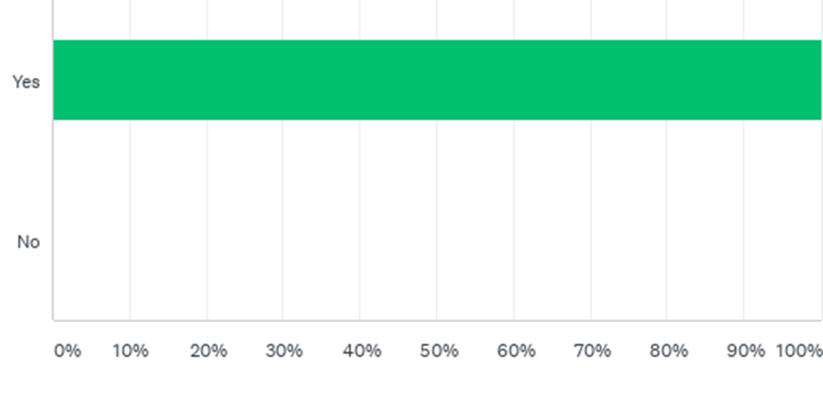
During the 2020 grant year (March 1, 2020 - February 29, 2021), did your agency receive a Fiscal Monitoring (audit for Ryan White expenses) visit?
RECIPIENT RESPONSE:
All subrecipient received a program monitoring visit during the 2020/21 grant year.
SUBRECIPIENT RESPONSES:

Slide 13
During the 2020 grant year (March 1, 2020 - February 29, 2021), did your agency request any technical assistance from the Recipient's office?
RECIPIENT RESPONSE:
Some subrecipients requested technical assistance regarding monitoring, monthly reimbursements, and budgets.
SUBRECIPIENT RESPONSES:

Slide 14
AEAM Questions to the Planning Council
Questions
During the 2020 grant year (March 1, 2020 - February 29, 2021), did the Recipients Office (City of Paterson) adhere to the Planning Council's recommendations by allocating a specific percentage of funds to each service category as approved by the Planning Council during the Priority Setting and Resource Allocations process? During the 2020 Ryan White Part A grant year (March 1, 2020 - February 28, 2021), did the Recipient's Office provide expenditure reports to the Planning Council at least 4 times? During the 2020 Ryan White Part A grant year (March 1, 2020 - February 28, 2021), did the Recipient's Office participate in the development of Needs Assessments? During the 2020 Ryan White Part A grant year (March 1, 2020 - February 28, 2021), did the Recipient's Office participate in the development and tracking of the Integrated HIV Prevention and Care Plan? During the 2020/21 Ryan White Part A grant year (March 1, 2020 - February 28, 2021), did the Recipient's Office participate in the development and update of Service Standards?

Slide 15
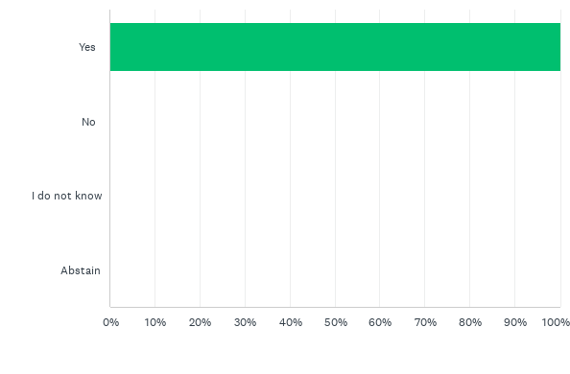
During the 2020 grant year (March 1, 2020 - February 29, 2021), did the Recipients Office (City of Paterson) adhere to the Planning Council's recommendations by allocating a specific percentage of funds to each service category as approved by the Planning Council during the Priority Setting and Resource Allocations process?
COMMISSIONER RESPONSES:

Slide 16
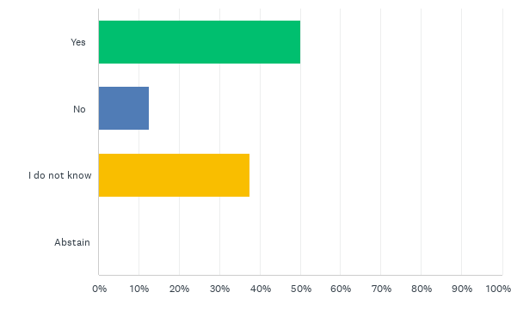
During the 2020/21 Ryan White Part A grant year (March 1, 2020 - February 28, 2021), did the Recipient's Office provide expenditure reports to the Planning Council at least 4 times?
COMMISSIONER RESPONSES:
Because we didn't get it.

Slide 17
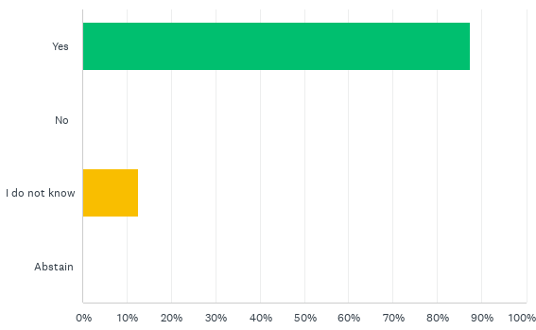
During the 2020/21 Ryan White Part A grant year (March 1, 2020 - February 28, 2021), did the Recipient's Office participate in the development of Needs Assessments?
COMMISSIONER RESPONSES:
Very little!

Slide 18
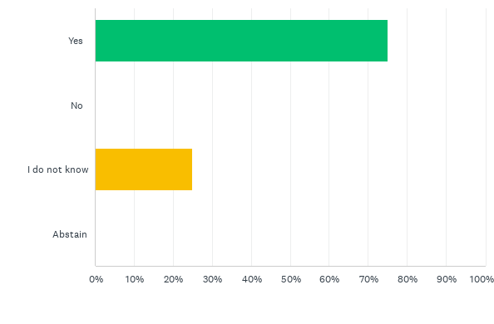
During the 2020/21 Ryan White Part A grant year (March 1, 2020 - February 28, 2021), did the Recipient's Office participate in the development and tracking of the Integrated HIV Prevention and Care Plan?
COMMISSIONER RESPONSES:
I think we were waiting on the new guidance and decided to use the Statewide plan.
Maybe from the "office" but not with the Planning Council.

Slide 19
During the 2020/21 Ryan White Part A grant year (March 1, 2020 - February 28, 2021), did the Recipient's Office participate in the development and update of Service Standards?
COMMISSIONER RESPONSES:
I think we were waiting on the new guidance and decided to use the Statewide plan.
Maybe from the "office" but not with the Planning Council.

Slide 20
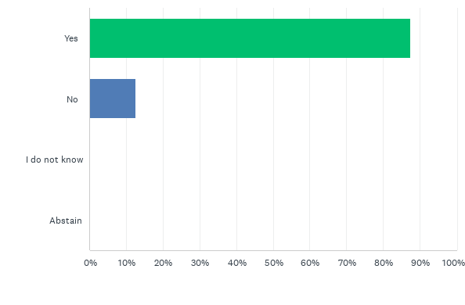
During the 2020/21 Ryan White Part A grant year (March 1, 2020 - February 28, 2021), did the Recipient's Office participate in the coordination of Planning Council Support operations?
COMMISSIONER RESPONSES:
Yes, Millie, Thomas and Deryk work well together. We can always count on Thomas and Deryk to let us know whats going on when Millie can't make it.
Because There was no coordination...she did it herself. PC was not involved.

Slide 21
Recommendations for AEAM Results?
SUGGESTED RESULTS:
August and September of 2021, the PC conducted the 2020 Assessment of the Efficiency of the Administrative Mechanism (AEAM) to assess the Recipient’s activities to ensure timely allocation/contracting of funds and payments to subrecipients. The results of the 2020 AAM suggest a great working relationship and open line of communication between the PC and the City of Paterson (Recipient). The Recipient does an extraordinary job in procuring services, reallocating funds, and ensuring that service delivery continues unaltered or without delay. During the 2020/21 grant year, COVID-19 has been a critical barrier that the Recipients office in concert with the Planning Council and Subrecipients, have been able to overcome and continue service delivery.

