Slide 1

2019 Orientation for Prospective New Members
Bergen-Passaic TGA
Chief Elected Official (CEO), Mayor Andre Sayegh
Administered by the City of Paterson, Dept. of Health and Human Services, Funded by Health Resources and Services Administration Bureau (HRSA), HIV/AIDS Bureau (HAB)

Slide 2
Welcome &
Introductions
Thank you for your interest to join the Planning Council.

Slide 3
What is the CARE Act?
The Ryan White CARE Act is named in honor of Ryan White, a young man who was diagnosed with HIV when he was 13. Ryan, with his mother and the rest of his family, fought to overcome the fear & ignorance of his neighbors in a small town in Indiana and became a symbol of bravery and integrity. Ryan died in 1990 at the age of 18.
During the latest reauthorization the Act was renamed. It is now called the Ryan White HIV/AIDS Treatment Modernization Act of 2009.

Slide 4
Part A
Part A of the Ryan White HIV/AIDS Treatment Modernization Act of 2009 (Ryan White HIV/AIDS Program) provides emergency assistance to Eligible Metropolitan Areas (EMAs) and Transitional Grant Areas (TGAs) that are most severely affected by the HIV/AIDS epidemic. To be eligible as a TGA, an area must have reported at least 1,000 but fewer than 2,000 new AIDS cases in the most recent 5 years.
We are a TGA.

Slide 5
What is the job of the Ryan White Treatment Modernization Act of 2009?
The Act provides grants to local and State programs to provide primary medical care and support services; health care provider training; and technical assistance to help funded programs address implementations and emerging HIV care issues.
Funds support services that enhance access to and retention in care.

Slide 6
What is the job of the Ryan White Treatment Modernization Act of 2009?
Provides for significant local and State control of planning and service delivery, contributing to innovative and practical approaches to the delivery of care.
Provides limited funds for administration, including planning, quality management, and evaluation.

Slide 7
Our Meetings
Planning Council meetings are generally once a month. The Planning Council meets the first Tuesday of the month.
PLUS
3 Standing Committees:
Steering Committee (leadership)
Planning & Development (P&D)
Community Development (CDC)
Quorum is required for all meetings.

Slide 8
What is the Planning Council’s Purpose?
Mission Statement: We strive to identify all individuals living with HIV/AIDS or at risk of HIV infection in Bergen and Passaic Counties and provide access to prevention, continuous care and support services.
Main purpose is: Priority Setting
Priority Setting of Services
Ranking (all services)
Allocation (don’t have to fund)

Slide 9
Work of the Steering Committee
The Steering Committee, commonly referred to as the executive or leadership committee, is made-up of the Chair, Vice Chair, committee chairpersons of P&D and CDC and three (3) at-large appointed members only.
The Steering Committee ensures that all the work of the Planning Council is completed in a timely and efficient manner.
Steering Committee oversees ALL Planning Council activities.

Slide 10
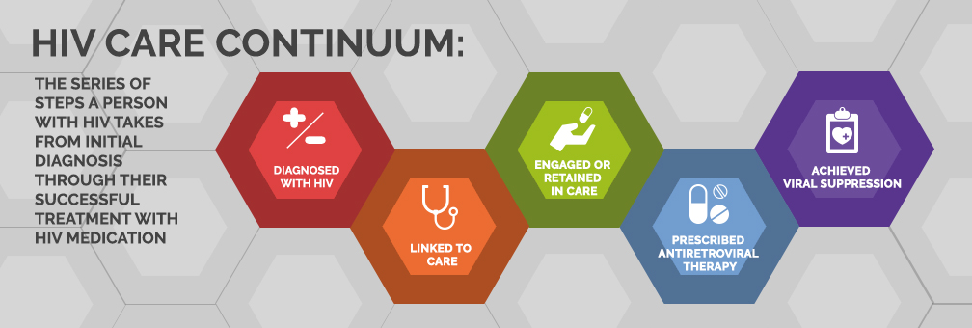
What is the Planning & Development Committee (P&D) responsible for?
P&D assists the Planning Council with the mandated activities set forth by HRSA.
P&D is charged with overseeing the Integrated HIV Prevention and Care Plan and takes the lead in the development and implementation of directives to the Recipient, needs assessment(s), the priority setting and resource allocations process (PSRA), updating service standards definitions.

Slide 11
Work of the Community Development Committee (CDC)
The CDC is responsible for membership recommendations, community engagement and events and organizing the annual Day of Capacity Building.
Aligned with the planning council’s overall mission, CDC works toward helping PLWH get the continuous care and support services they need by promoting available resources.

Slide 12
Organization Chart
Planning Council
Karen Walker, Chair
Khalilah Daniels, Vice-Chair
Recipient’s Office
Millie Izquierdo, RWHAP Director
Steering Committee
Admin Support
Sandra Gonzalez
Collaborative Research: Thomas Rodriguez-Schucker
Community Dvlpmnt. Comm.
CDC
Eduardo Elizondo, Chair
Nick Kubisky, Vice-Chair
Planning & Dvlpmnt. Comm.
P&D
Karen Walker, Chair
Jerry Dillard, Vice-Chair

Slide 13
How We Get Things Done
Group Process: This includes a code of conduct, as well as rules for committee and full planning council operations, meeting times, and locations. These are usually described in the bylaws.
By-laws
Code of Conduct
Robert’s Rules
    The Right of the Majority to Rule
    The Right of the Minority to be heard, and
    The Right of the individual to have a voice in the decision-making process

Slide 14
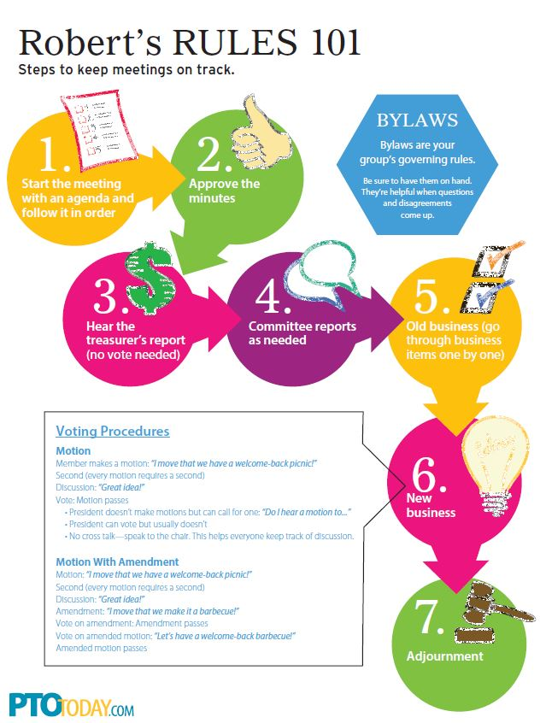

Slide 15
Items that Determine Membership
1. Demographics of our TGA
2. HRSA (Health Resources and Services Administration)
3. By-laws
4. Intergovernmental Agreement

Slide 16
HRSA
The overall membership and PLWH membership must be reflective of the HIV cases in the TGA.
Chair and Vice Chair must live in the TGA.
Council Members must live and/or work in the TGA.

Slide 17
Intergovernmental Agreement
2/3 of Membership must come from Passaic County
1/3 of Membership must come from Bergen County

Slide 18
Overview
Term of Membership is 3 years.
Alternates are substitutes for members and must represent the same membership category.
Orientation is mandatory for membership.

Slide 19
ALL MEMBERS SERVE AT THE PLEASURE OF THE ChieF Elected Official (CEO), that is the Mayor of the City of Paterson,
THE CEO APPOINTS ALL MEMBERS

Slide 20
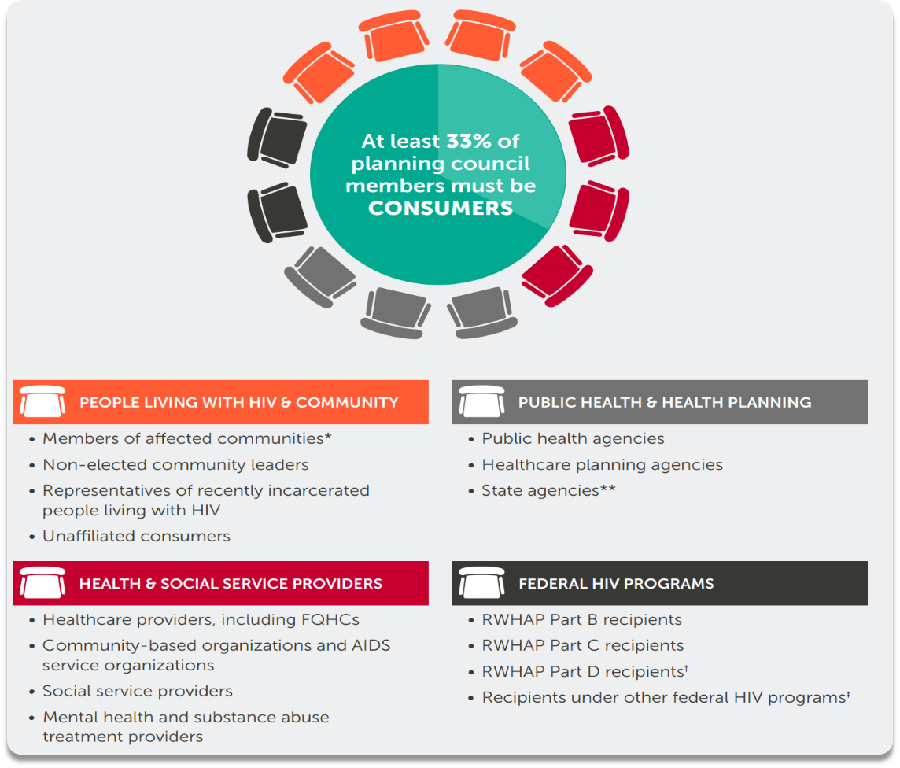

Slide 21
HRSA Requirement:
At least 33% of our membership must be PLWH who:
  receive HIV related services from Part A
  are not officers, employees, and do not represent any such entity (non-aligned)
  reflect the demographics of the population of individuals with HIV

Slide 22
PLWH Members
Are entitled to be reimbursed for their participation in such activities as planning council meetings, committee meetings, retreats, and conferences.
Specific expenses that will be reimbursed include: Travel (mileage), Babysitting, Loss of Wages.
Council members must submit a bill, with receipts in order to be reimbursed. Reimbursement is limited to 3 meetings per month and a total maximum of $25.00 per meeting.

Slide 23
Grounds for Removal
Absent from 3 meetings in a 12-month period, or
Represented by alternate at more than 6 meetings in a 12-month period, or
Violation of the Code of Conduct

Slide 24
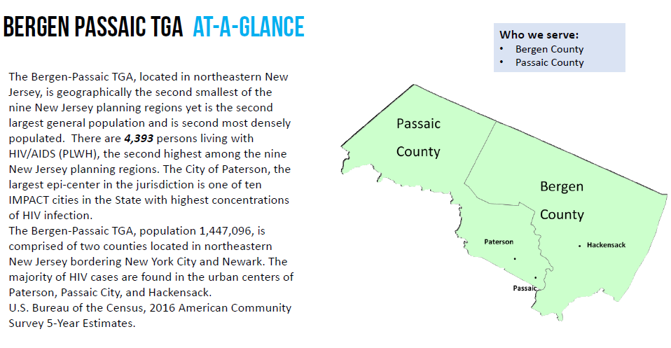

Slide 25
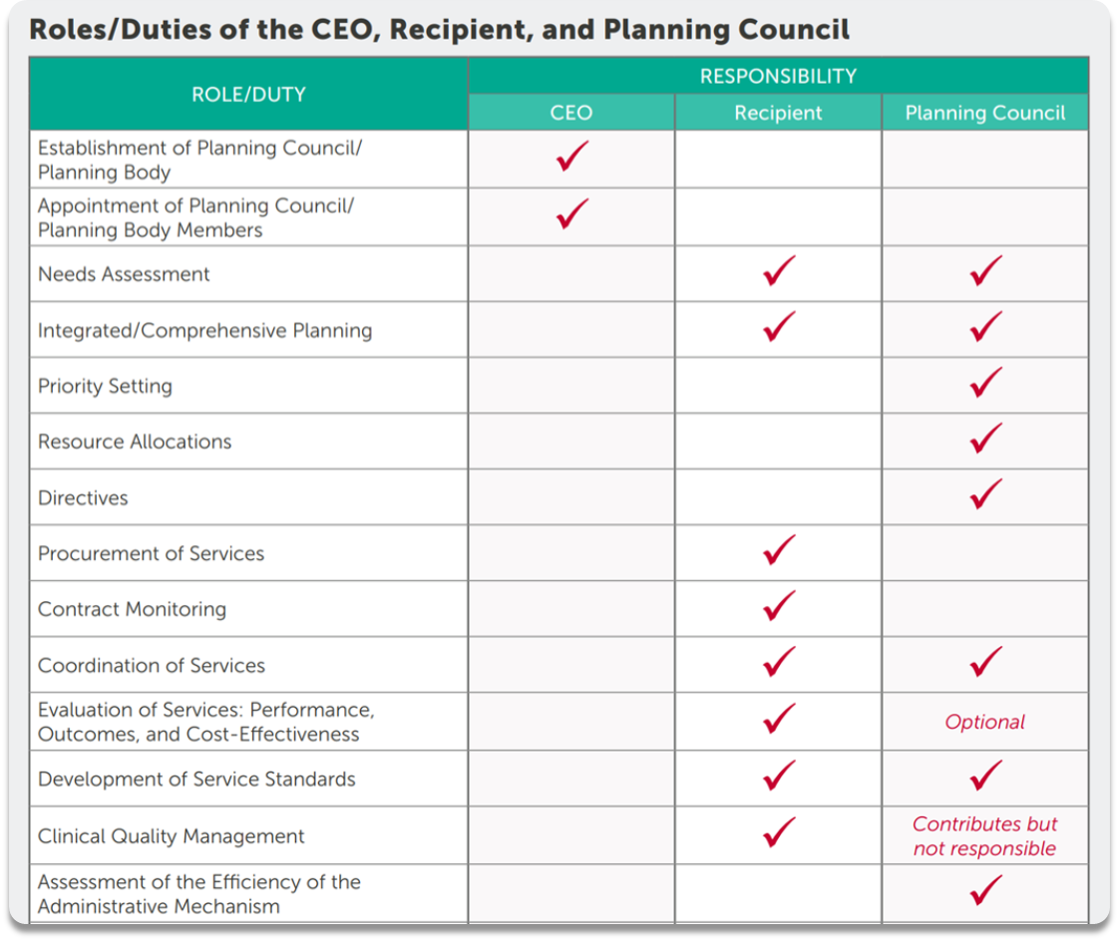

Slide 28
Questions/Comments
Thank you for your time today!
We hope to see you again soon.

